Slide 1

IE3
Industrial Engineering and Management of European Higher Education
WP1- Researching HEI training offer and company good practices in the field of IE&M
[Name of the IO]
The European Commission support for the production of this publication does not constitute endorsement of the contents which reflects the views only of the authors, and the Commission cannot be held responsible for any use which may be made of the information contained therein

Slide 2
[WP1- description, aims, organization of the work]
The aim of this WP is to identify the training pathways currently provided by European HEIs and the good practices in use within the companies involved in the IE&M field, with particular attention to Industry 4.0-related topics.
Study on the educational offer provided by IE&M departments and the good practices in use within partner companies
Text mining analysis (i.e. a meaningful extraction of data from the academic syllabi gathered) in order to define the main convergences and divergences of the current educational offer in the IE&M field.
Milestone
ML1: HEI educational offer and good practices in IE&M with respect to Industry 4.0 key features

Slide 3
[Tasks: description, timeframe, responsibilities]
Task 1.1: Design and Plan the desk research on the educational offer and company good practices in the field of IE&M (lead: PUT; University and company partners)
Task 1.2: Carrying out in-depth researches on HEI educational offer (lead: PUT; University partners)
Task 1.3: Carrying out in-depth researches on the good practices in the companies involved in the field of IE&M (lead: PUT; University and company partners)
Task 1.4: Preparation of a report on education and training convergences and divergences and company good practices in IE&M. (lead: PUT; University and company partners)

Slide 4
Task 1.1: Design and Plan the desk research on the educational offer and company good practices in the field of IE&M
Collecting syllabi from: (1) project partners , (2) other HEIs offering IE&M programmes
Question to be asked: HOW MANY?
Definition and description of Industry 4.0 concept and its elements (key words)
Designing questionnaire on syllabi development scheme (how often, responsibilities, legal frame)
Designing semi-structured interview on training offer from companies: (1) project partners, (2) other companies
Question to be asked: HOW MANY?
2 months – corrected after brief discussion

Slide 5
Task 1.2 Carrying out in-depth researches on HEI educational offer (lead: PUT; University partners)
Text analysis of syllabi provided (e.g. Voyant tools, Clarin – online tools)
Check list on accuracy of syllabi (interviews with academics)
Check list on teaching practices (interviews with academics)
Developing template for results presentation
3 months

Slide 6
Task 1.3 : Carrying out in-depth researches on the good practices in the companies involved in the field of IE&M (lead: PUT; University and company partners)
Carrying out semistructured interviews with companies on good practices
2 months

Slide 7
Task 1.4- Preparation of a report on education and training convergences and divergences and company good practices in IE&M.
Report - convergences and divergences of the current educational offer in the IE&M field between HEIs and companies of different partner countries
20-30 pages with 1-3 pages of extended summary by PUT
Definition and description of I4.0 concept and its elements by PUT
Convergences and Divergences as per R1.3 by PUT
Company Good Practices by PUT
3 months

Slide 8
Gantt chart
 | 1-Nov-19 | 1-Dec-19 | 1-Jan-20 | 1-Feb-20 | 1-Mar-20 | 1-Apr-20 | 1-May-20 | 1-Jun-20 | 1-Jul-20
 | M1 | M2 | M3 | M4 | M5 | M6 | M7 | M8 | M9
WP1
T1.1 - Design and Plan the desk research on the educational offer and company good practices in the field of IE&M
T1.2 - Carrying out in-depth researches on HEI educational offer
T1.3 - Carrying out in-depth researches on the good practices in the companies involved in the field of IE&M
T1.4 - Preparation of a report on education and training convergencies and divergences and company good practices in IE&M.

Slide 9
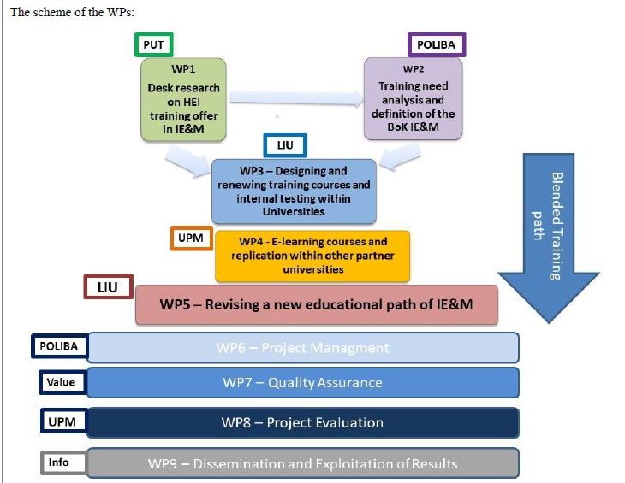
[Link with the others WPs]
WP1 has a tight relationship with WP2, addressing the training needs in the field of IE&M.

Slide 10

[Beyond the project proposal: Suggestions/improvements]
Kind invitation for active participation in BRAINSTORMING SESSION on WP1

