Slide 1

IE3
Industrial Engineering and Management of European Higher Education
WP2 - Educational Demand:
Training Need Analysis and Definition of the BoK on IE&M
Polytecnic University of Bari
22_11_2019
The European Commission support for the production of this publication does not constitute endorsement of the contents which reflects the views only of the authors, and the Commission cannot be held responsible for any use which may be made of the information contained therein

Slide 2
WP2: Aims
Ad-hoc designed questionnaires/interviews
WP1
Students
Academics
Companies
Educational Offer
Educational Demand
Need Analysis
Development of
Body of Knowledge (BoK)

Slide 3
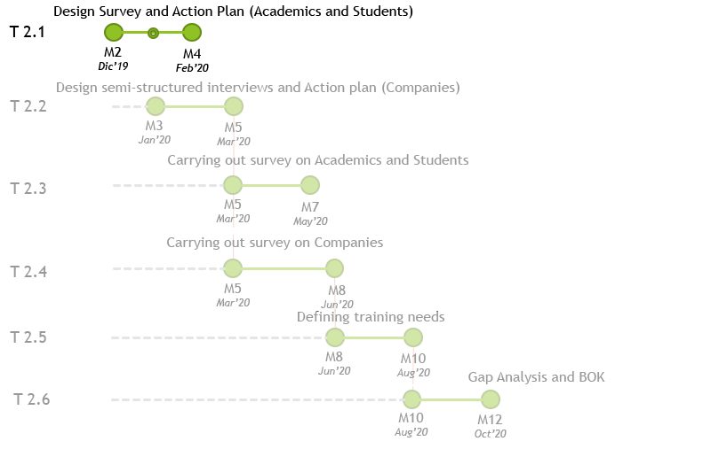


WP2: Tasks
Results 2.1: Action plan for the survey for Students
and Academics
  The reference document for carrying out the surveys addressing the Students and Academics, includes:
    Identification of a national coordinator in each partner country;
    Identification of key topics around which the surveys should revolve;
    Methodologies, techniques and tools leading the surveys;
    Targets to be reached;
    …
Methodology for the survey:
  National Coordinator
  Key Topics: predefined topics (Knowl. Contents/ Method.); free topics
  Questionnaires (Qs) Definition distinguished by target:
    Academics $≥$100 Qs: $≥$60 from Countries of academic partners
    $≥$40 from Other EU countries (AIM + ESTIEM networks)
    Students $≥$800 Qs: $≥$400 from Countries of academic partners
    $≥$400 from Other EU countries (AIM + ESTIEM networks)
  Template of Results for Reporting
Validation of Questionnaires and Methodology for the Survey (M3)
Questionnaires and Methodology for the Survey ready to be adopted (M4)
Designing the Survey for Students and Academics and Action Plan
Leader: POLIBA
Support: University, Company and Associated partners
Define a first version of the questionnaires to be conducted, according to the different target groups (Students, Teaching staff/academics)

Slide 4
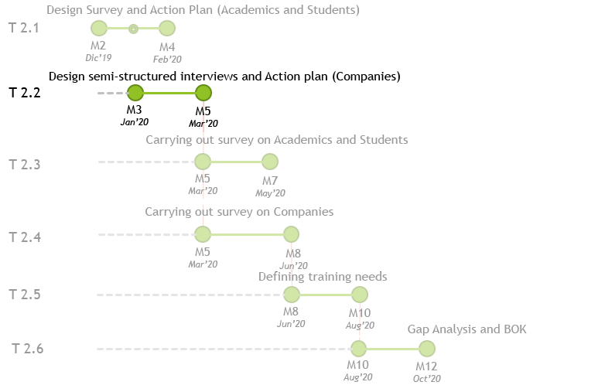

WP2: Tasks
Design the Semi-Structured Interviews for Entrepreneurs and Action Plan Leader: POLIBA
Support: University, Company, AIM /ESTIEM
To complete the analysis also entrepreneurs will be investigated through semi- structured questionnaires - for understanding the main needs they have when hiring new potential workforce.
Results 2.2: Action plan for semi-structured
interviews for entrepreneurs
This document will be the reference for carrying out the
interviews to entrepreneurs in the IE&M field:
    Identification of a national coordinator in each partner country;
    Identification of key topics around which the interviews should revolve;
    Methodologies, techniques and tools to deliver the interviews;
    Target to be reached;
    …
Methodology for the interviews:
  National Coordinator
  Key Topics: predefined topics (Knowl. Contents/ Method.);
  free topics
  ‘Ad hoc’ semistructured Questionnaires / Interviews (QIs):
    SMEs $≥$24 QIs: from Countries of academic partners
    Sector: Manufacturing by parts (e.g. Automotive) $≥$12
    Process Production (e.g. Steel Company) $≥$4
    Service (e.g. Logistics, ICT solution, Consulting) $≥$8
    Profile of Company Interviewed: CEO, R&D, HRM, Senior Manager
  Template of Results for Reporting
Trial by University / Company Partner for piloting the Semi-Structured QIs (M4-5)
Semi structured Questionnaires/Interviews and Methodology ready to be adopted (M5)

Slide 5
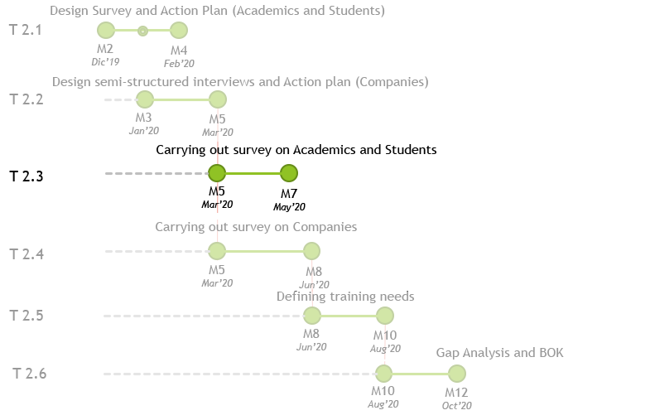
WP2: Tasks
Conducting the survey for Students and Academics
Leader: POLIBA
Support: University, Company and Associated partners

Slide 6
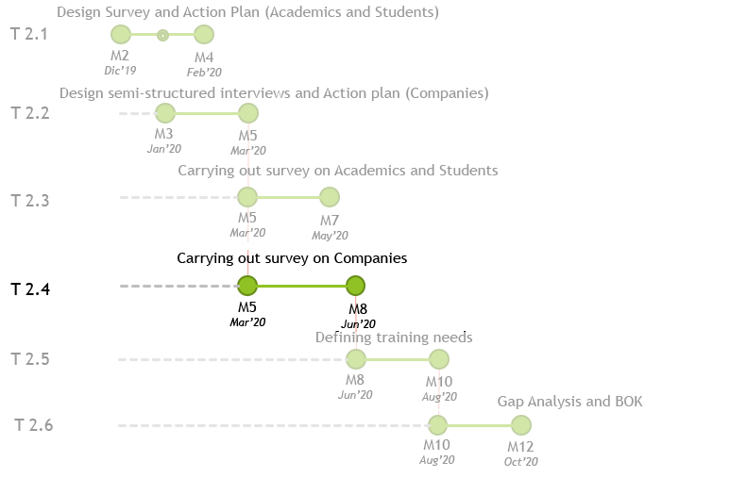
WP2: Tasks
Conducting the semi-structured interviews to entrepreneurs
Leader: POLIBA
Support: University and Company

Slide 7

WP2: Tasks
Defining the Training Needs (Milestone)
Leader: POLIBA
Support: University and Company partners
According to information collected by the University partners, POLIBA will define the training needs emerged from the sector
Results 2.3: Report on Training Needs Analysis
The report will be include:
    50-60 pages with 3 pages of extended summary by Poliba
    Quantitative Elaborations of Qs (as per R2.1) by Poliba
    Quanti/Qualitative Description of QIs (as per R2.2) by each University Partners
    Overview on Training Needs by Poliba

Slide 8
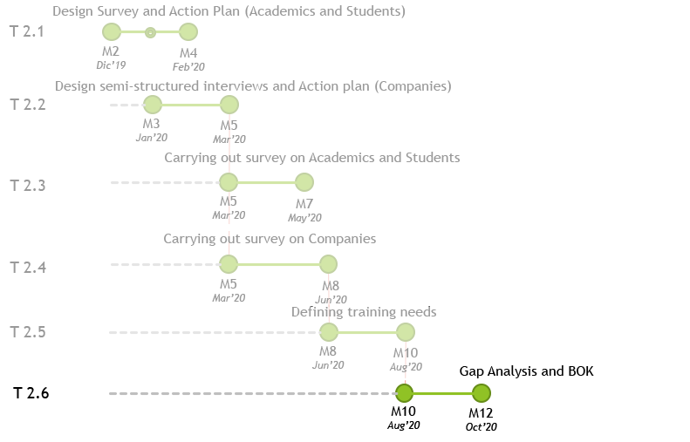
WP2: Tasks
Conducting the Gap Analysis and Development of the Bok (Milestone)
Leader: POLIBA
Support: University and Company partners
Book of Knowledge (BoK) developement,
i.e. the conceptual framework underlying the following actions and the technical specs upon which reforming the courses, can be developed without leaving any topical issues uncovered.
Results 2.4: Report on Gap Analysis & BoK
The report will be include:
    20-30 pages with 1-3 pages of extended summary by Poliba;
    Convergences and Divergences as per R2.3 by Poliba;
    Company Good Practices by Poliba;
    Body of Knowledgeby Poliba:
      Conceptual Framework
      Technical Specification to reform University Course
      …

Slide 9
Questions ?

