Slide 1


IE3
Industrial Engineering and Management of European Higher Education
WP 4 description
[UPM]
The European Commission support for the production of this publication does not constitute endorsement of the contents which reflects the views only of the authors, and the Commission cannot be held responsible for any use which may be made of the information contained therein

Slide 2
[WP4 description, aims, organization of the work]
WP4: e-learning implementation
WP4 Aim (Aug 2021-July 2022)
The aim of this WP is:
- to prepare e-learning modules starting from the training materials prepared and tested in WP3. This modules (prepared according to the BoK) will be public and available for everybody interesting in them
- to learn, for partner universities and companies, how to build e-learning materials
- to testing the effectiveness of blended courses (providing traditional classes and e-learning)
The duration of the e-learning courses will be set at 4-8 hours, in order to increase their attractiveness to the students willing to attend them and to be included also in other courses as part of the compulsory/optional learning activities. After being validated by the entire partnership, the 4 e-learning modules will be finally made public.
Universities: turn their learning materials into e-learning modules and commit to have them tested by at least 15 students for each specific module (45 testers per university).
Companies: supporting the Universities in the preparation of the e-learning modules, validating the e-learning courses received by the HEI of their country and test them (each company will review two courses, one from the local University and one for one other country

Slide 3
[WP4 description, aims, organization of the work]
WP4: e-learning implementation
WP4 Structure (Aug 2021-July 2022)
T4.1.- Setup the technical environment & serious gaming extensions (M21-23)
T4.2.- Defining pedagogical criteria for the e-learning courses (M23-24)
T4.3.- Preparation of e-learning modules (M25-28)
T4.4.- Test of the e-learning modules (M29-31)
T4.5.- Analyzing the feedback received (M32)
T4.6.- Development of the improvements (M33-35)
Focus: To prepare e-learning modules defined in WP3

Slide 4
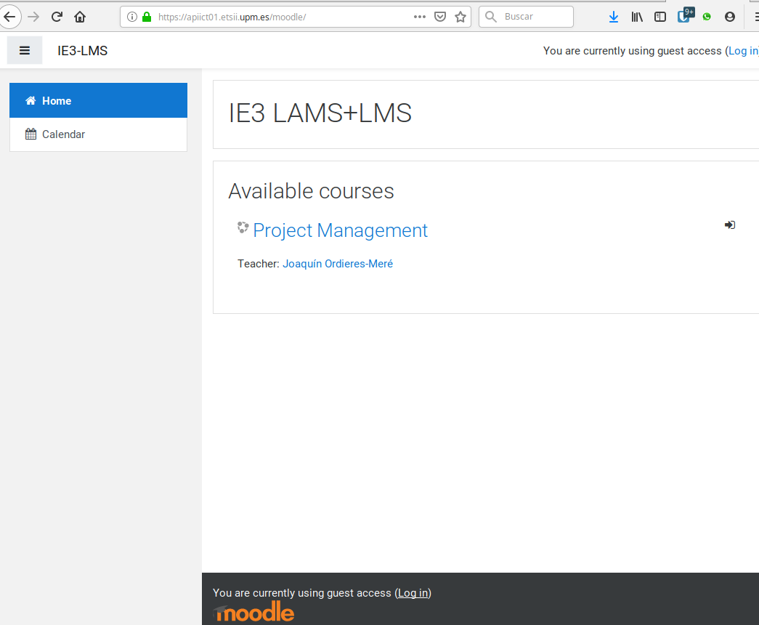


[Tasks: description, timeframe, responsibilities]
T4.1 Structure (Aug 2021-October 2021)
T4.1.- Setup the technical environment & serious gaming extensions
https://apiict01.etsii.upm.es/moodle/
https://apiict01.etsii.upm.es/moodle/

Slide 5
[Tasks: description, timeframe, responsibilities]
T4.2 Structure (October 2021-November 2021)
T4.2.- Defining pedagogical criteria for the e-learning courses and development of a Pilot Action Plan (M23-24)
Key aspects:
Knowledge based on micro-pills ?
Multimedia content ?
Active performed tasks ?
Linked sequence of learning tasks ?
Group of Tasks inside Themes ?
Group of Themes inside Modules ?
Gamification ?
Badges ?

Slide 6
[Tasks: description, timeframe, responsibilities]
T4.3 Structure (November 2021-February 2022)
T4.3.- Preparation of e-learning modules starting from the training materials prepared (M25-28)
Key aspects:
Each partner defines the Module, Themes and Lessons.
Each partner collects & build-up the required materials.
Each partner builds the logic inside the LAMS-LMS
For technical issues UPM will try to help, including the IaaS.

Slide 7
[Tasks: description, timeframe, responsibilities]
T4.4 Structure (March 2022-May 2022)
T4.4.- Test of the e-learning modules (M29-31)
Key aspects:
Each partner will provide support to the University delivering the content.
Cooperation will be also encouraged, to deliver modules in a cooperative way.
Survey for feedback collection will be also produced
For technical issues UPM will try to help, including the IaaS.

Slide 8
[Tasks: description, timeframe, responsibilities]
T4.5 Structure (June 2022)
T4.5.- Analyzing the feedback received by the users (M32)
Key aspects:
Each partner will collect feedback from their students.
Commonalities and singularities will be analyzed by the module’s author.
After sharing the summaries per module, focus group will be conducted to summarize improvements.

Slide 9
[Tasks: description, timeframe, responsibilities]
T4.6 Structure (July 2022 – September 2022)
T4.6.- Development of the required improvements (M33-35)
Key aspects:
Each partner will implement the improvements into the materials.
Each partner will report about the final version of the materials.
Each partner will pack the final version of the module.

Slide 10
[Results: description, timeframe, responsibilities]
Each partner will fill in a Quarterly Report describing the activities conducted in the WP, checked by the WP7 and WP8 Lead partner against the project indicators and deadlines
Content creation
Implement scientific dissemination
Deliver the modules in associated partners
Test effectiveness & identify the required improvements
Outreach activities

Slide 11
[Results: description, timeframe, responsibilities]
R4.1 Memorandum on technical criteria for the development of e-learning modules and requirements of the technical environment (UPM) [M23 / Oct 2021]
R4.2 E-learning Pedagogical Strategy (UPM) [M24 / Nov 2021]
R4.3 Prototype of e-learning modules (All) [M28 / Mar 2022]
R4.4 IE3 - E-learning modules Implementation Action plan (All) [M31 / Jun 2022]
R4.5 E-learning modules evaluation (All) [M32 / Jul 2022]
R4.6 Final version of e-learning modules (All) [M35 / Oct 2022]

Slide 12
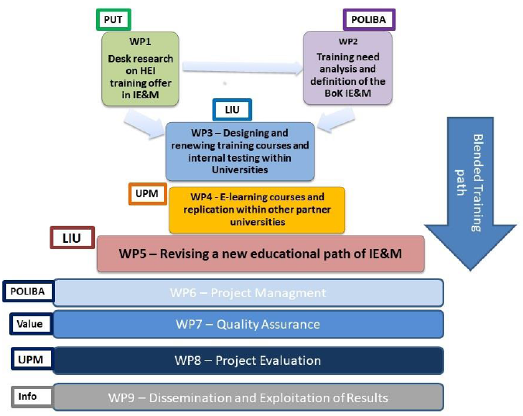
[Link with the other WPs]

Slide 13

[Beyond the project: Suggestions/ improvements]
Key aspects:
Pay SPECIAL attention to scientific dissemination (& outreach (WP9) and networking.
Extend the IE3 model with other experiences.
Disseminate the IE3 improved model.
Explore the non-regular education areas (professional education, long-life learning, etc.).

