Slide 1

WP4.- e-learning module evaluation
Partner: LiU
This project has received funding
from the European Union’s Erasmus+
programme under grant agreement
N. 2018-2279/001-001

Slide 2
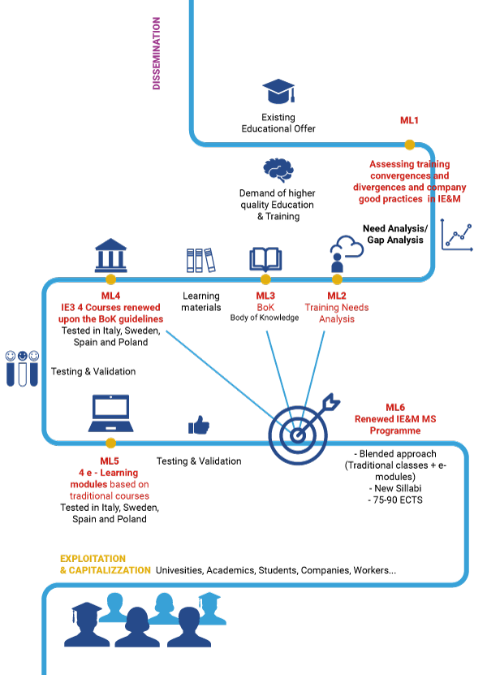
WP4.- Analysis of the Module Survey
Module title: Machine Learning in Operations Management
N. Students completing the course: 0: LIU 22: Poliba 0: PZN 26: UPM
Total Number: 48
Summary of suggestions:
Machine Learning in Operations Management
Module usefullness (average number): | 4.21
Develop practical skills (average number): | 4.00
Satisfaction for the Methodology (average number): | 4.35
Usefulness of the way of learning (average number): | 4.31
Quizzes are convenient (average number): | 4.15
Hours spent for training (min/avg/max): | 2.87 (Min:1.0; Max:9.0)
Hours spent for exercices (min/avg/max): | 1.69 (Min:0.3; Max: 7.0)
Above the initial expecations (average number)?: | 3.90

Slide 3
WP4.- Analysis of the Module Survey
Module title: Machine Learning in Operations Management
Professionals: ?: IMPLEMA ?: Bosch ?: Alcomot ?: Arruti
Total Number: 15
Summary of suggestions:
Machine Learning in Operations Management
Module usefullness (average number): | 4.31
Develop practical skills (average number): | 3.75
Satisfaction for the Methodology (average number): | 4.19
Usefulness of the way of learning (average number): | 4.56
Quizzes are convenient (average number): | 4.19
Hours spent for training (min/avg/max): | 3.25 (Min:1.0; Max:10.0)
Hours spent for exercices (min/avg/max): | 1.59 (Min:0.0; Max: 5.0)
Above the initial expecations (average number)?: | 3.94
Notes:
Total har 15 svarat varav flera från universitetspartners. Det går inte att se om någon kommer från Alcomot eller Arruti som enkäten utformats.

Slide 4
WP4.- Analysis of the Module Survey
Module title: Machine Learning in Operations Management
Written comments
Video lectures
Good with several videos and presentations
Too slow pace
No subtitles
Audio poor at times
Exercise in Excel
Difficult with Excel in other languages
Missing video guide for the exercise
Too challenging, even though good instructions
Other
More practical exercises wanted
Good to be able to retake quizzes
Very satisfied
Notes:
Fritextsvar som är sammanställda. Totalt 10 svar. Alla är inklistrade nedan.
I don't think any improvements need to be done.
I really appreciated that each module had its own video and presentation, which were well structured. Although, from my point of view, videos should've had subtitles on them. Apart from that, I also appreciated that you could retake the quizzes to get the highest grade. I believe the exercise was too challenging, even though the instructions were fully detailed and easy to follow, and the solution was available. With everything being said, I think the course was really interesting and useful in my professional life, and I would strongly recommend it.
I think that the course was interesting, but the fundamentals of the course itself were not enough for my initial expectation. I would definitely fix the audio in the videos, adding subtitles where possible. Sometimes the voice was poor and it was a bit hard to fully understand it. The exercise part was not clear at all, I faced some issues with formulas because of syntax of Excel and the final task was definitely not clear at all, so I lost double time to understand what I had to do. My suggestion for the exercise part is to make it interactive or to have a video solution/explanation for it.
In general I am very satisfied, I suggest to insert more practical exercises and to create a guide to use the algorithm on the data quiz.
nothing in particular
Since my excel was in Spanish, it was diffficult to translate the functions, specially the larger ones.
Thank you for this learning opportunity.
The exercise was not working properly even though I followed every step of the guide, so I had to use other methods. Also the subject was something I have already studied profoundly. If the excel exercise would have worked for me as intended it would have been a nice addition to my knowledge as I have only used programming to make the code for machine learning.
Video lessons are too slow. Excel exercise was great, there could be videos on that, and incorporate more exercises.
Voice of lecture is not to good, I couldn't hear what he was saying

Slide 5
WP4.- Analysis of the Module
Module title: Machine Learning in Operations Management
There are four recorded lectures, one recorded introduction, five quizzes, self reflection, and one calculation exercise
Recorded time = 9.5 + 16 + 21.5 + 14 + 4 = 65 minutes, Quiz time 5 * 15 = 75 minutes,
self reflection 30 minutes: total 170 minutes (2.83 hours)
2.83 hours planned vs 2.97 hours actual
Exercise time = 1.50 hours
1.50 hours planned vs 1.67 hours actual
Analysis of criticality
89 participants, 62 answered the quizzes
48 got all quizzes correct (77.4%)
The exercise was answered by 60 participants, 57 correct (95%)

Slide 6
WP4.- Evaluation of the Module
Strengths of the module (at design level)
Lectures and lecture material by company professional working with Machine Learning
Teaching material tested in program course at LiU
Relevant topic, using standard tools such as MS Excel
Do you consider the students realized them? Yes
Do you consider the professionals realized them? Yes
Ideas for module improvement:
Subtitles
Recorded instructions for exercise
Audio enhancement

Slide 7
WP4.- Evaluation of the Module
Based on the experience, please list the main points to emphasize for the revision of the module:
Recording quality
More exercises in relevant topics, recorded instructions
More visible connection to Operations Management
Reinforced added value, when the improvements are implemented (estimated):
Relevant topic for future professionals
Stand-alone module to use anytime, no context necessary
Advanced mathematical exercise in MS Ecxel

Slide 8
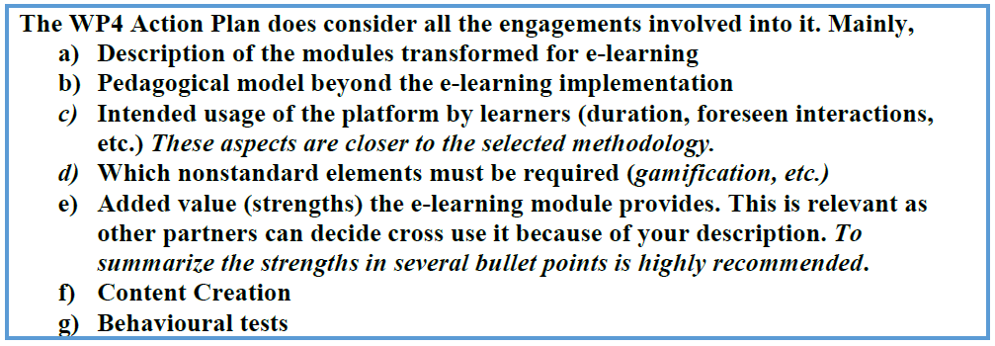
WP4.- Evaluation of the Module
Reminder
Each Partner must provide for the deliverables:
Each partner MUST provide a report addressing the previous aspects having the focus on their implemented modules at their earliest convenience, as the UPM must integrate them regarding the R4.4.

