Slide 1
Machine Learning in Operations Management
Ie3 Module

Slide 2
Machine Learning in Operations Management
Modules | Content | Material | Time | Who
Introduction | Introduction to the Module | Recorded introduction + slides | 4.0 min | FP
Section 1 | Introduction to Machine Learning | Recorded lecture 1 + slides | 9.5 min | ER, FP
 |  | Quiz 1, 3 questions | 15.0 min | ER
Section 2 | Machine Learning & How it Works | Recorded lecture 2 + slides | 16.0 min | ER, FP
 |  | Quiz 2, 3 questions | 15.0 min | ER
Section 3 | Machine Learning & Decision Making | Recorded lecture 3 + slides | 21.5 min | ER, FP
 |  | Quiz 3, 3 questions | 15.0 min | ER
Section 4 | Machine learning & Operations Management | Recorded lecture 4 + slides | 14.0 min | ER, FP
 |  | Quiz 4, 3 questions | 15.0 min | ER
Exercise | Machine Learning Exercise | The exercise document | 90 min | FP, MH, ER
 |  | Quiz 5, 10 questions | 15.0 min | FP
Seminar | Self reflection seminar | Slides | 30.0 min | FP
Examination |  | Quiz | 30 min | FP

Slide 3
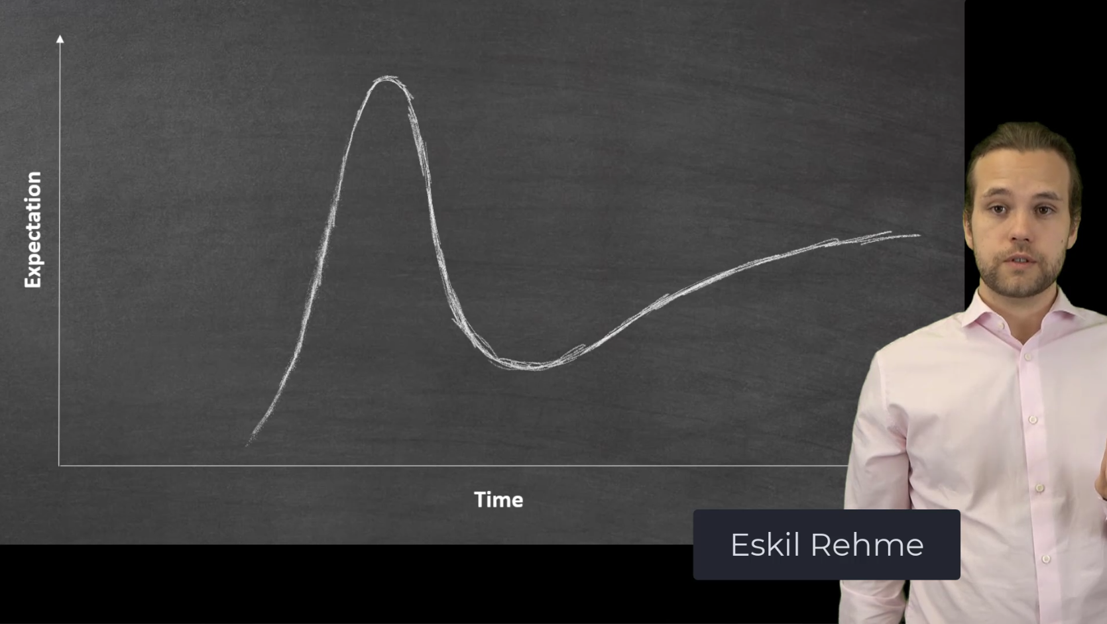
Section 1: Recorded Lecture

Slide 4
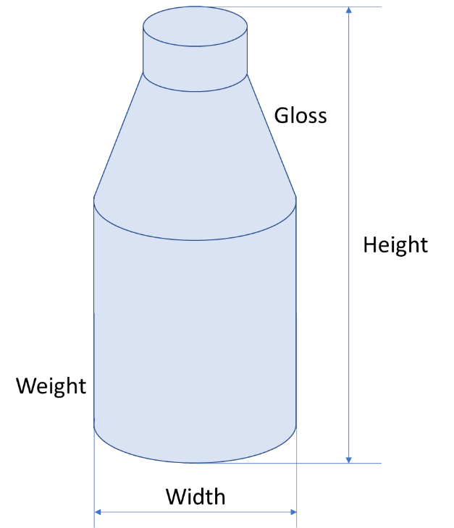
Machine Learning Exercise
The organic shampoo Green Guck is sold in hand made paper bottles of different shapes and sizes
The shampoo comes in three different fragrances, Original, Apple, and Swamp
Determine which shampoo goes in which bottle by use of a Machine Learning algorithm
The exercise is done in MS Excel

