Slide 1

WP4.- e-learning module evaluation
Partner: PUT
This project has received funding
from the European Union’s Erasmus+
programme under grant agreement
N. 2018-2279/001-001

Slide 2
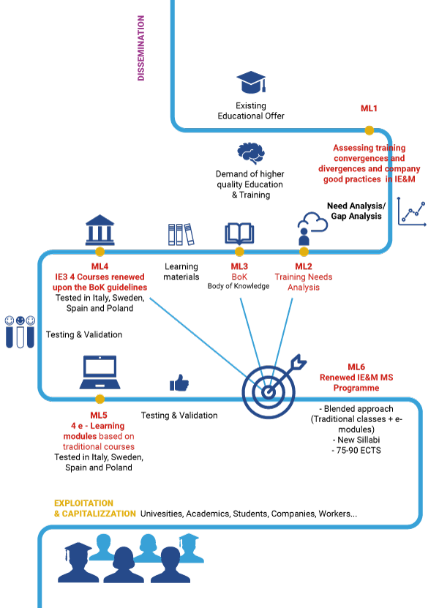
WP4.- Analysis of the Module Survey
Module title:
N. Students completing the course: 1 LIU 13 Poliba NA PZN 15 UPM
Total Number: 30
Summary of suggestions:
Title of the module | Supply Chain Management
Module usefullness (average number):
Develop practical skills (average number):
Satisfaction for the Methodology (average number):
Usefulness of the way of learning (average number):

Slide 3
WP4.- Analysis of the Module Survey
Module title:
N. Students completing the course: 1 LIU 13 Poliba NA PZN 15 UPM
Total Number: 30
Suggestions:
- I would try to give more instructions for completing the upload excersises
- The general perception of the course is a bit jagged and uneven.
- I believe the resources provided for each module were too wide. I would have appreciated more concise information.
+ I appreciated that retaking the quizzes was allowed
+ I think the course was really interesting and useful in my professional life, and I would strongly recommend it.
+ I'm very positive towards the exercises.
+ The course is easy to understand and use.
+ The student cannot actually perform supply chain planning in real life - see the outcome, and draw conclusions from the outcome
Title of the module | Supply Chain Management
Hours spent for training (min/avg/max): | 8
Hours spent for exercices (min/avg/max): | 3
Above the initial expecations (average number)?:

Slide 4
WP4.- Analysis of the Module
(1 or 2 slides)
Module title: Supply chain management
Videos: 12; text documents: 11; websites: 7; data sets: 3
Estimate of the student workload in terms of duration: expected 12hrs – average 11hrs, number of interactions: 12 (quizzes and exercises)
Estimate the student engagement in case studies, exercises and quizzes in terms of duration: expected 3hrs – average 3hrs
Analysis of criticality
Did the students achieve the expected learning objectives?
Balance as-is and expected
Quantitative and qualitative assessment

Slide 5
WP4.- Evaluation of the Module
Strenghts of the module (at design level)
Diversified content (various materials)
Small portions of knolwedge checked
Interesting issues covered
Do you consider the students realized them? Yes, in most cases
Do you consider the professionals realized them? Yes, in most cases
Ideas for module improvement:
Using simulation in practical exercises
Using more complex case studies to reflect business conditions
Using more interaction options
More automation in students assessment

Slide 6
WP4.- Evaluation of the Module
Based on the experience, please list the main points to emphasize for the revision of the module:
More real-life examples
More practical exercises
More concise conent presentation
Reinforced added value, when the improvements are implemented (estimated):
More practical skills development
More connection to business environment
Content easier to understand

Slide 7
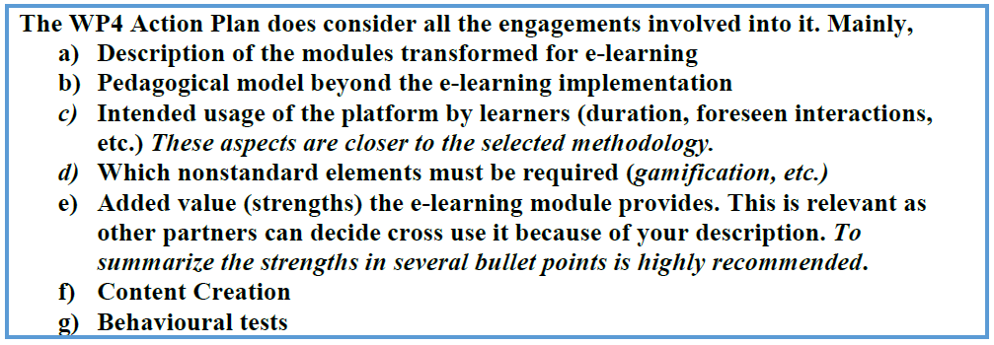
WP4.- Evaluation of the Module
Reminder
Each Partner must provide for the deliverables:
Each partner MUST provide a report addressing the previous aspects having the focus on their implemented modules at their earliest convenience, as the UPM must integrate them regarding the R4.4.
Beta version completed by the end of June, final version whenever feedback from Sweden is received

