Slide 1

WP4. e-learning
module evaluation
POLIBA-UNIBA
This project has received funding
from the European Union’s Erasmus+
programme under grant agreement
N. 2018-2279/001-001

Slide 2
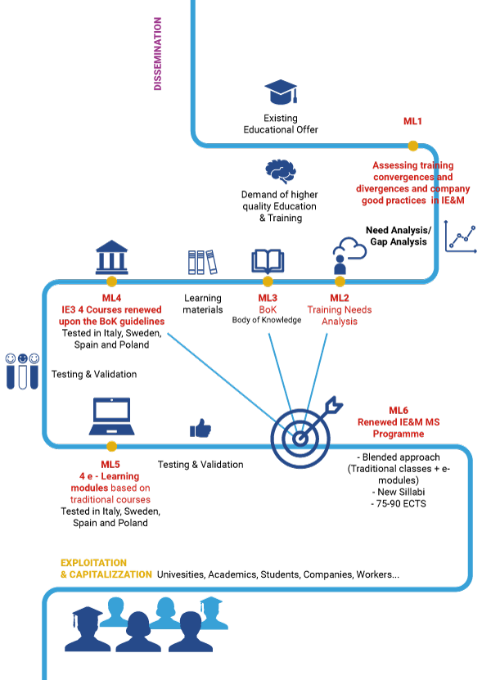
WP4.- Analysis of the Module Survey
Module: Lean Systems and Continuous Improvement
N. Students completing the course: 1 LIU ___ Poliba ___ PZN 21 UPM
Total Number: 22
Title of the module | Rank (1-5)
Module usefullness (average number): | 4,6
Develop practical skills (average number): | 4,3
Satisfaction for the Methodology (average number): | 4,5
Usefulness of the way of learning (average number): | 4,5
Quizzes are convenient (average number): | 4,2
Hours spent for training (min/avg/max):
Hours spent for exercices (min/avg/max):
Above the initial expecations (average number)?: | 4,2

Slide 3
WP4.- Analysis of the Module Survey
Module: Lean Systems and Continuous Improvement
N. Professionals: 1 IMPLEMA 1 Bosch 1 Alcomot 1 Arruti
Total Number: 4 (2 partial)
Summary of suggestions:
Title of the module
Module usefullness (average number):
Develop practical skills (average number):
Satisfaction for the Methodology (average number):
Usefulness of the way of learning (average number):
Quizzes are convenient (average number):
Hours spent for training (min/avg/max):
Hours spent for exercices (min/avg/max):
Above the initial expecations (average number)?:

Slide 4
WP4.- Analysis of the Module
Module: Lean Systems and Continuous Improvement
Types and number of e-learning resources used
2 Units – 4 Topics - 14 Videos (plus pdf recitation)
  9 Lectures (Video pills)
  5 Practical cases (+ 2 xls tool + data acquisition)
10 Quiz Session (9 intermediate + 1 final)
Estimate of the student workload in terms of duration, number of interactions, ... (comparison of actual vs planned)
P. 2 hours in watching video + 1 hour for personal study + 1 hour for QQ and practical case
A. Great variability (1 to 6 h) - Mean value 3,2
Estimate the student engagement in case studies, exercises and quizzes in terms of duration, # of interactions, ... (comparison of actual vs planned)
    P. 1 hour in watching video + 0,5 hour for personal study + 0,2 hour for QQ
    A. Great variability (0,5 to 3 h) - Average value 1h

Slide 5
WP4.- Analysis of the Module
Module: Lean Systems and Continuous Improvement
Analysis of criticality
Did the students achieve the expected learning objectives?
Partially yes. We had students from only one University!
The workload between theoretical resources and practical activities is well balanced 2 to 1 ratio.
22 students completed the activities.
  Final Assessment MIN/MAX/AV → 6,5/10/9,5
  Final Grade Overall MIN/MAX/AV → 66/100/94
4 companies partially completed all the activities (2 only the final assessment)
Qualitative judgments of students are satisfactory
If possible, evaluate the achievement of the learning objective also compared to the background (prior knowledge)
Not possible. We had students from only one University!

Slide 6
WP4.- Evaluation of the Module
Strengths of the module (at the design level)
Covers general aspects of the topics (no prior specific knowledge required) and then tends to go deep into the contents (from general to specific)
Each topic is clearly divided into “pieces” of knowledge that are self-concluding (where possible)
Tends to show practical implications of the theoretical knowledge
Force the students to test their knowledge and skills frequently by QQ motivating at the same time the participation and the attention

Slide 7
WP4.- Evaluation of the Module
Strengths of the module (at the design level)
Do you consider the students realized them? (student’s responses)
I don't think any improvements need to be done.
In my opinion, it was a really interesting course. Usefull knowledge that I will take with my into my professional future.
Do you consider the professionals realized them?
I enjoyed the course content as it was mostly new concepts and material for me. I think the overall structure was good, and that the frequent quizzes and practical assignment acted as a good measurement of how much information I had attained from each section. The lectures along with the access of the Ppt were a good combination of tools which enabled me to get through the course well. I did enjoy that the course content was created specifically to the course and that the lectures were generic.
Ideas for module improvement (from students!)
Practical assignments did not seem very practical → Need of engagement!
Content was a little boring (maybe gamification would help?)

Slide 8
WP4.- Evaluation of the Module
OPEN POINTS FOR DISCUSSION
Based on the experience, please list the main points to emphasize for the revision of the module:
...
...
…
Reinforced added value, when the improvements are implemented (estimated):
...
...
…

Slide 9
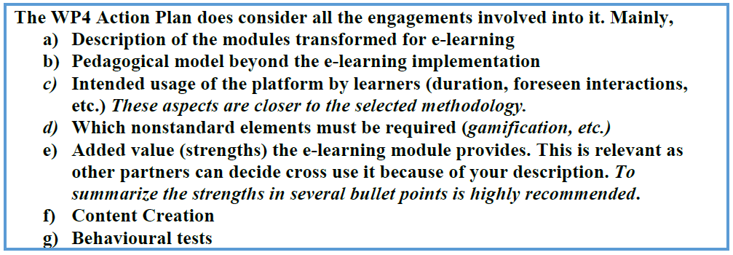
WP4.- Evaluation of the Module
Reminder
Each Partner must provide for the deliverables:
Each partner MUST provide a report addressing the previous aspects having the focus on their implemented modules at their earliest convenience, as the UPM must integrate them regarding the R4.4.

