Slide 1

WP9. FINAL
CONFERENCE
This project has received funding
from the European Union’s Erasmus+
programme under grant agreement
N. 2018-2279/001-001

Slide 2
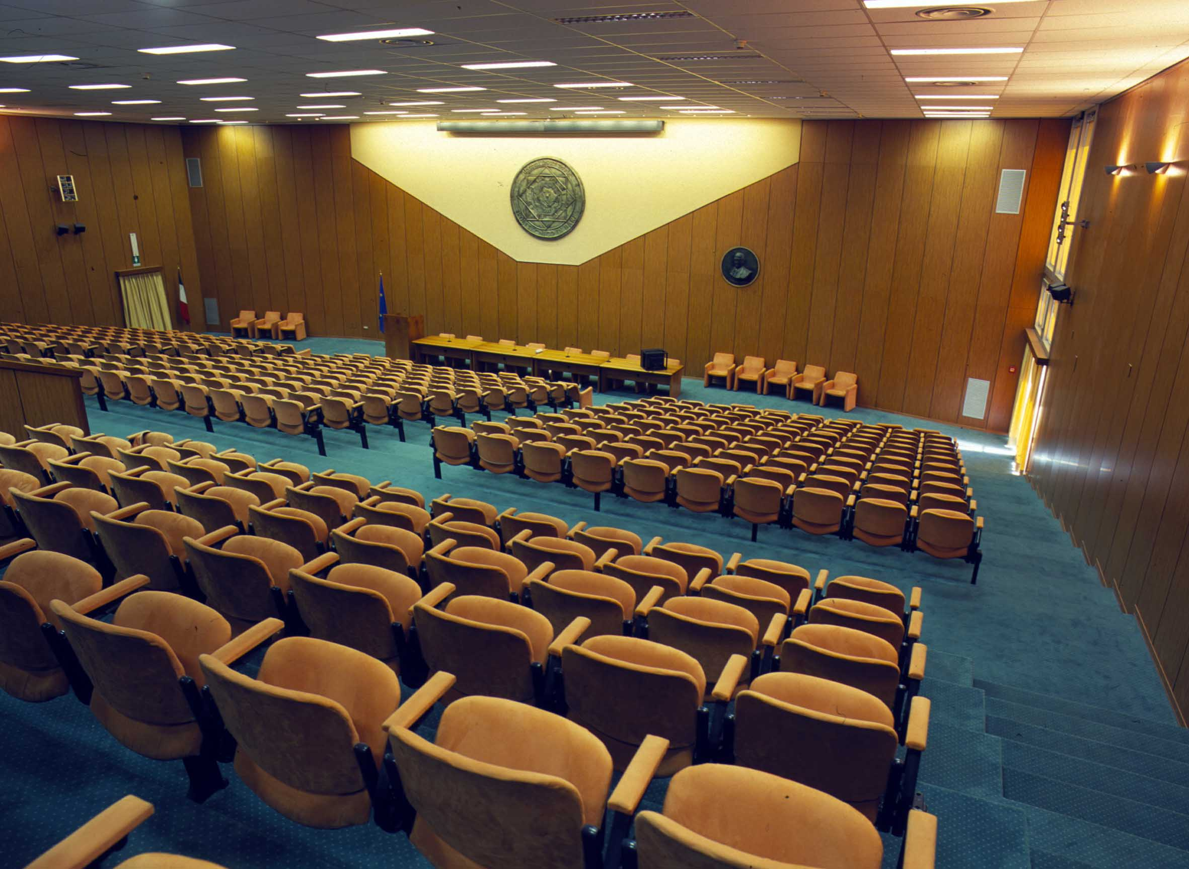
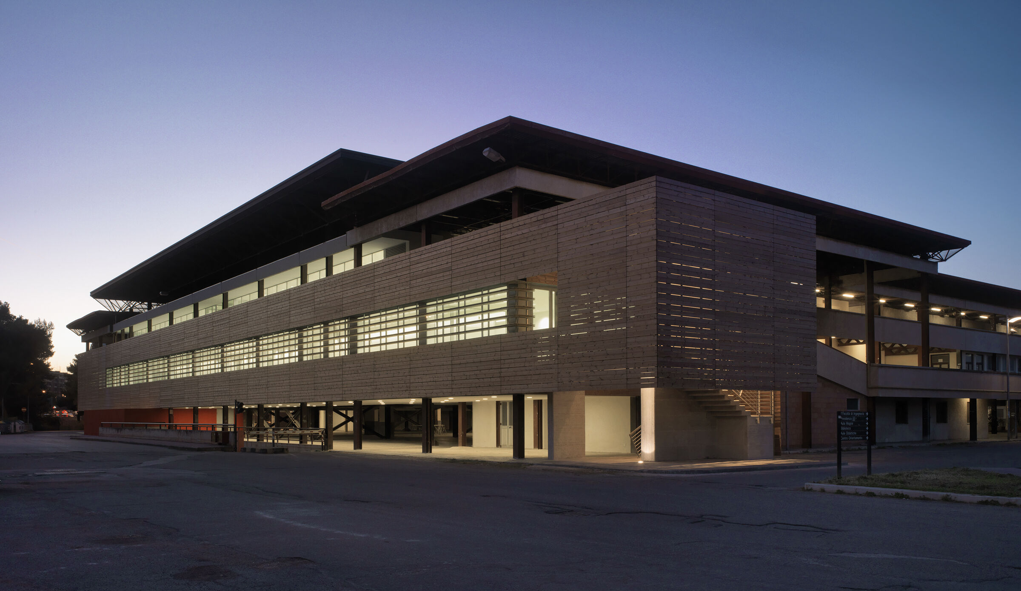
Final Dissemination Conference
Late January 2023 – first week of February 2023
Location: PoliBa Main Conference Hall
On-line (Youtube channel, Webex)

Slide 3
Format
One-Day Conference with Institutions, Academics, Students and Companies
  Thursday
  (Friday)
Morning: Institutions and Invited Speakers
Afternoon:
  a. One Technical Workshop (IE3 Results)
  b. Two Tracks (external contribution)
Treats
  a. Do you think we can personally give 3 to 4 lectures on the main WP Outcome?
  a. Who is the audience?
  b. How many external contributions do we expect?
  b. How can we involve colleagues from abroad?

Slide 4
Invited Speakers
EU representative
Prof. M. TAISCH (PoliMi – World Manufacturing Forum)
Representative from AIM
Representative from Companies (VW?)

Slide 5
Draft Agenda
9.00-9.15 Welcome - Institutions
9.15-9.30 The IE3 Project
9.30-10.00 EU representative
10.00-10.30 Prof. M. TAISCH (PoliMi – World Manufacturing Forum)
10.30-11.00 Coffe Break
11.00-11.30 Representative from AIM (ESTIEM) - Stakeholders
11.30-12.00 Representative from Companies (VW?) - Stakeholders
12.00-12.30 Round table?
12.30-12.45 Conclusion
13.00-14.00 Lunch

Slide 6
Draft Agenda
14.00-14.10 Technical Workshop - Welcome
14.15-14.45 Gap Analysis
14.45-15.15 BoK
15.15-15.45 Coffe Break
15.45-16.15 e-learning experience
16.15-16.45 A new European Master in IE&M
16.45-17.00 Final Conclusion
20.00-22.00 Dinner?

Slide 7
Suggestion
Name?
Format?
  One day
  Multiple days
Invited Speakers?
a. Topics for the workshop?
a. The audience for the workshop?
b. Title Tracks?
b. Speakers?

