Slide 1

WP9 - Dissemination: overview on the activities conducted
and planning new activities
Partners: InfoTech
This project has received funding
from the European Union’s Erasmus+
programme under grant agreement
N. 2018-2279/001-001

Slide 2
WP9: Dissemination: overview on the activities conducted and planning new activities
Articles
Website update
Social media update

Slide 3

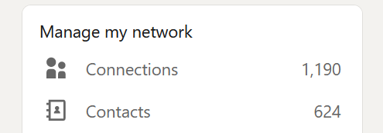
WP9: Dissemination: overview on the activities conducted and planning new activities
Facebook
LinkedIn
YouTube channel
    State of the art

Slide 4
WP9: Dissemination: overview on the activities conducted and planning new activities
The only result that remains to be delivered is R9.5 Final dissemination report
However, there are several activities to carry out:
    Overall dissemination activities conducted by partners → Link to the drive folder
    National dissemination conference
    International conference

Slide 5
THANK YOU FOR YOUR ATTENTION
Contacts:
progetti.infotech@gmail.com (InfoTech)
info@infotechsrl.net (InfoTech)
gianluigi.depascale@gmail.com (InfoTech)

